Slide 1
BOLTSS

Slide 2
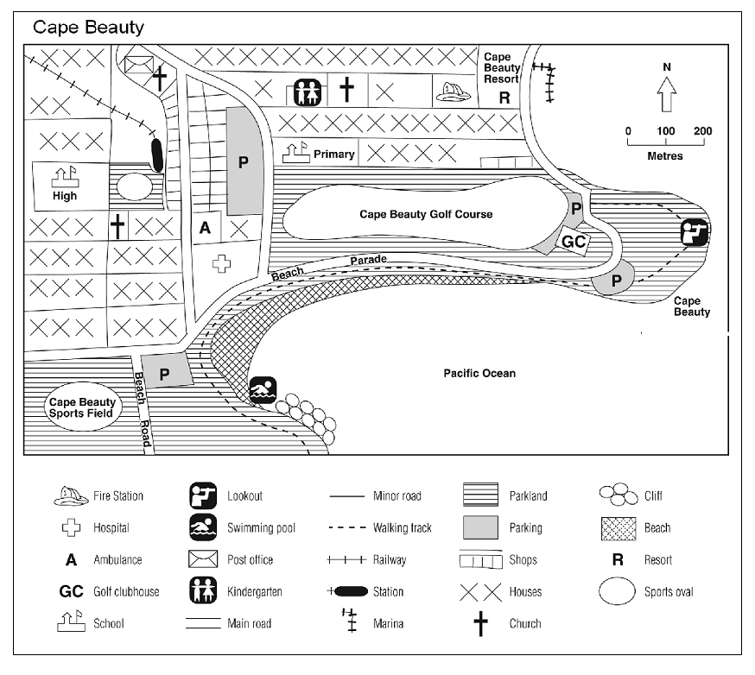
What are the features of maps?
Border

Slide 3
What are the features of maps?
Orientation:
Shows
direction
on a map

Slide 4
What are the features of maps?
Legend:
Explains the
symbols used
to represent
features or
objects

Slide 5
What are the features of maps?
Title:
Names the
place a map
is representing

Slide 6
What are the features of maps?
Scale:
The relationship
between a unit
of length on a
map and the
corresponding
length over
ground

Slide 7
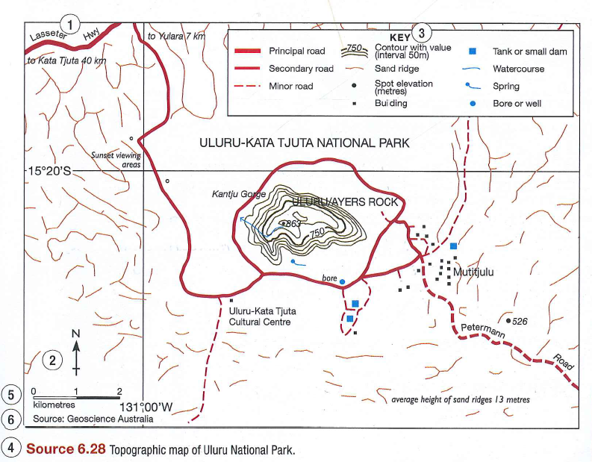
What are the features of maps?
Source:
A list of places where the map-maker found the information on the map.

Slide 8
BOLTSS
Border – A straight edge around the outside of the map.
Orientation – Indicates direction, nearly always by an arrow pointing to North.
Legend (key) – This explains any symbols or colours used.
Title – A description of the information contained in the map.
Scale – Shows the comparison between the distance on the map and the distance in the actual area mapped.
Source – A list of places where the map-maker found the information on the map.

Slide 9
Applying BOLTSS
1. Read the information on your handout about Ancient China and its Geography.
2. On the timeline, highlight the Warring States period.
3. Look at the map showing China’s geography during the Warring States Period.
4. On your map, circle and label the various elements of BOLTSS.

