Slide 1
INFOGRAPHICS

Slide 2
WHAT ARE INFOGRAPHICS
Turn to the person beside you and come up with an explanation of what you think an infographic is.
Make sure you discuss this carefully with a person……you might be asked to share your idea with the class.

Slide 3
INFOGRAPHICS
Information graphics or infographics
are graphic visual representation
of information, data or knowledge
intended to present information quickly and clearly

Slide 4
WATCH THESE VIDEOS
https://www.youtube.com/watch?v=x3RTS1JfMy8
https://www.youtube.com/watch?v=Ku-gQNzz7R4
https://www.youtube.com/watch?v=VQbFX2QzbOI

Slide 5
Things to consider
Audience – who is your target audience?
Content – what information is needed?
Graphics – Are you choosing the right graphics?
Text / Language – Is it easy to read and does the audience understand the language you are using?
Colours – what colours work together? Do you use lots of colour or use a colour scheme?
Layout – Is it the layout organised?

Slide 6
What makes a infographic?
Readable – use clear language and grammar
Legible – all poster text should be readable from 1 meters away.
Well 0rganised – group items logically, visually for impact.

Slide 7
GRAPHICS
All graphics are related to the poster.
Use colour, photos, charts, graphs to support your poster.
Graphics have explanations explaining what they are.

Slide 8
LOOK AT THESE INFOGRAPHICS
Download the pages document on the Weebly.
Unit 4 / Deep Learning Task / Pros & Cons
Look at the following infographics. List the pros an cons for each infographic.
You have 15 minutes to complete this. We will then share these ideas with the class

Slide 10
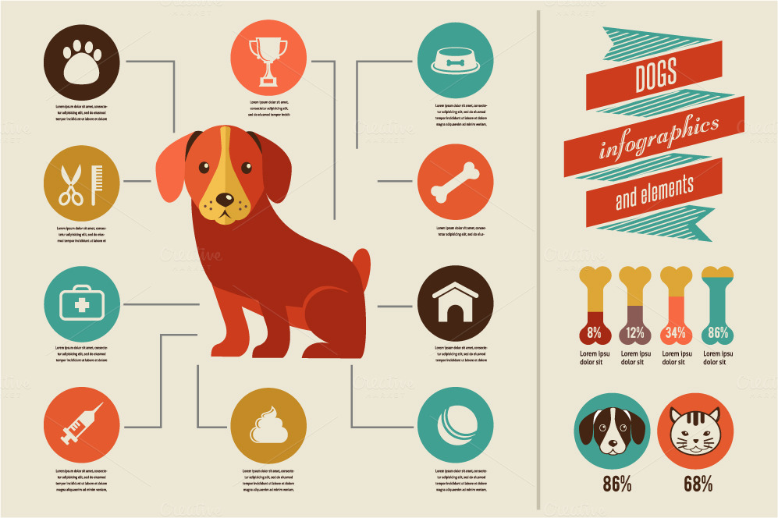

Slide 11
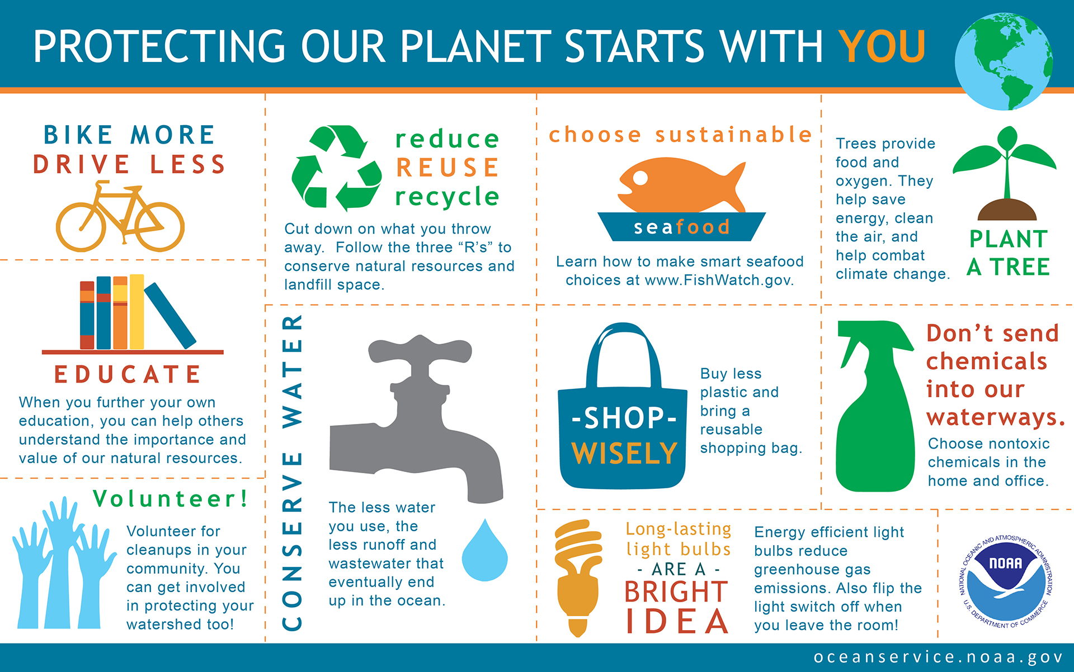

Slide 12
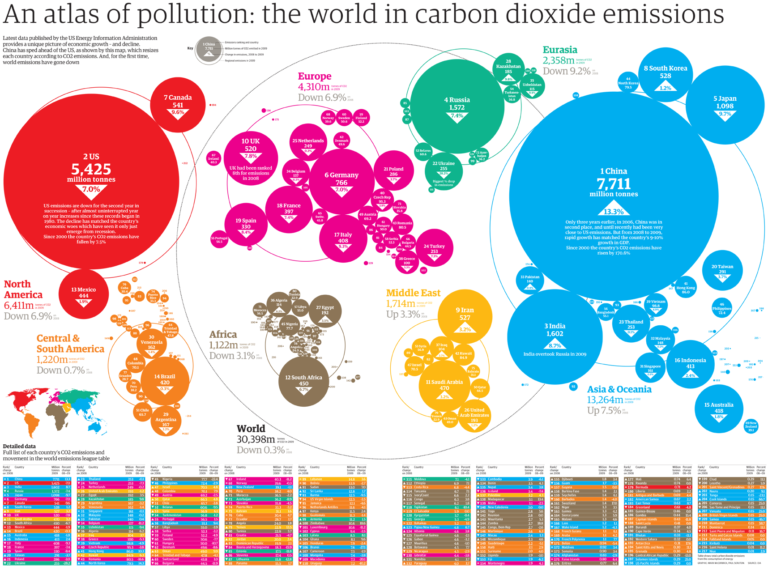

Slide 13
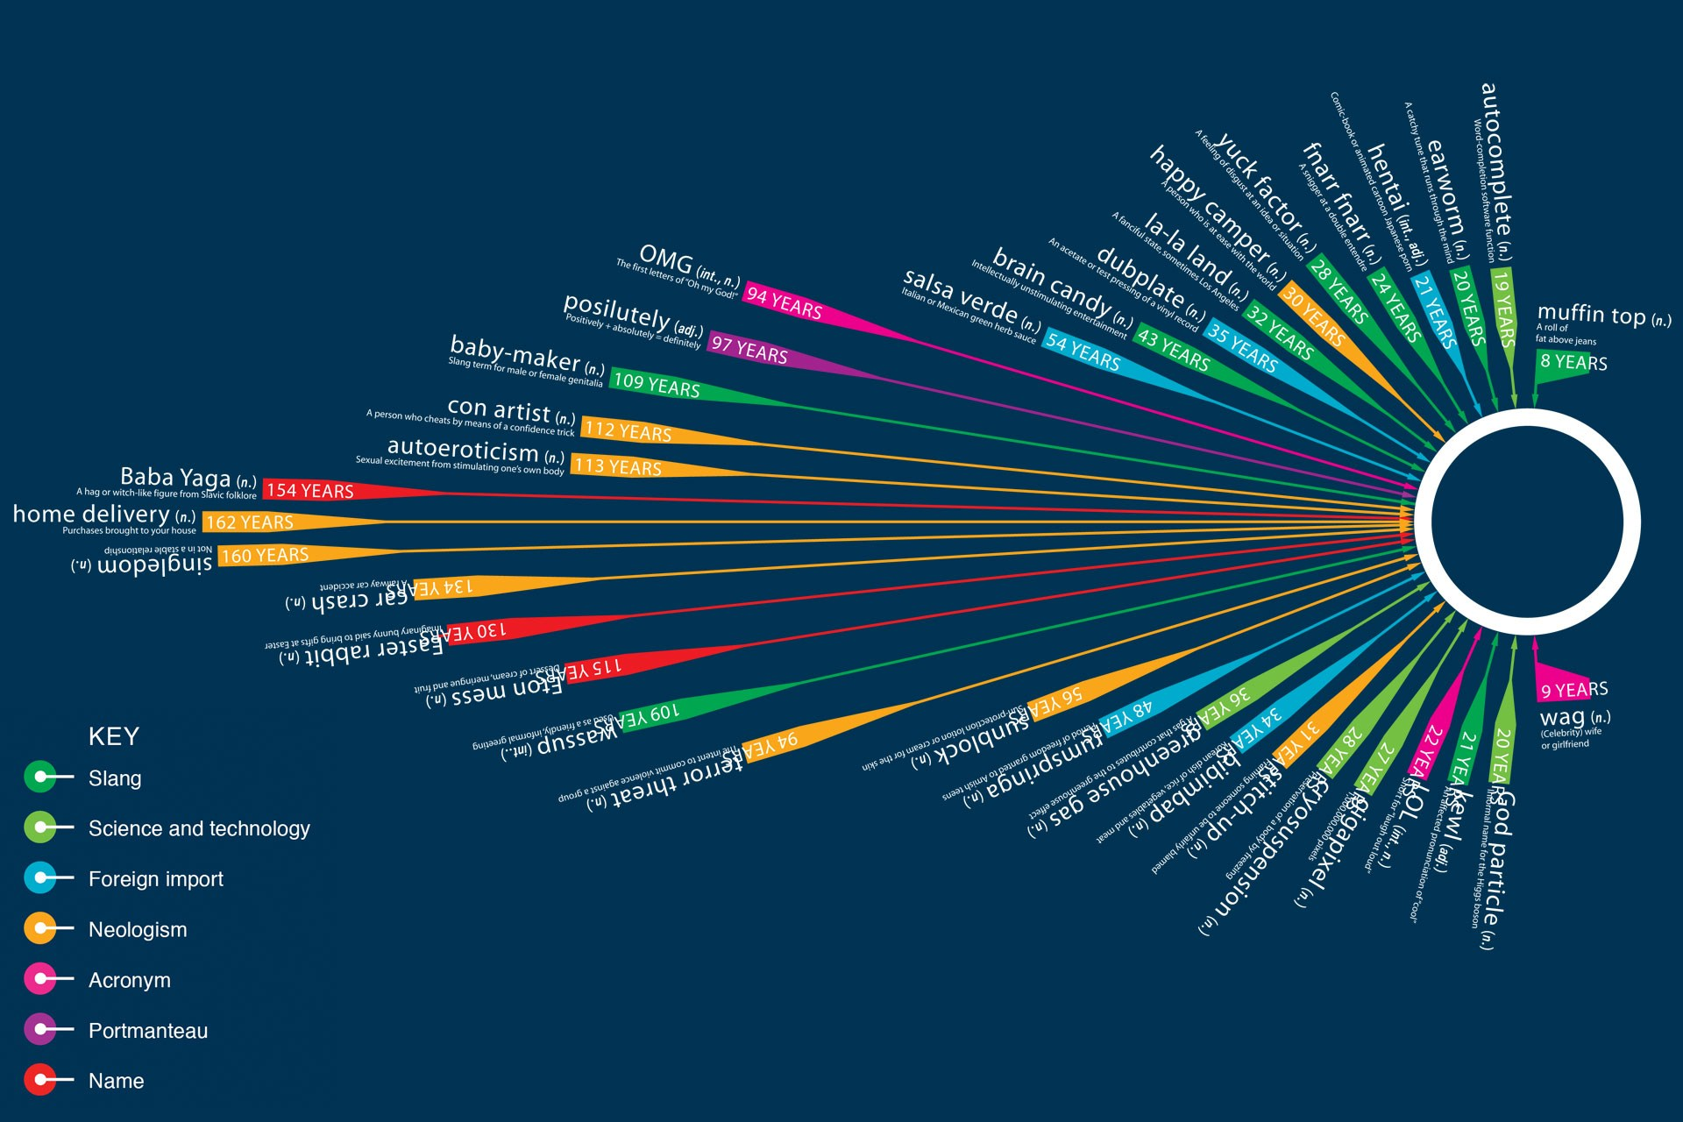

Slide 14
