Slide 1
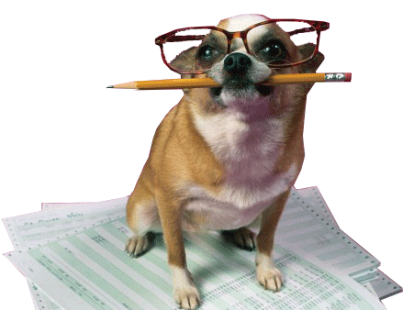
Writer’s Workshop
Here we use pen and paper to push our writing skills!

Slide 2
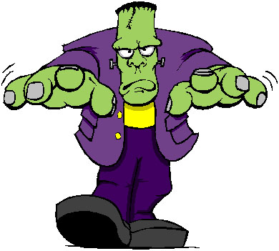
We are going to write a FRANKENSTEIN TEXT. Like Frankenstein, who was made up of random body parts, your story will be made up of random contributors.
You will have 5 minutes to start a story and write the orientation. You’ll then swap and the next person will add the next paragraph. You’ll then swap and the next person will add the next paragraph. You’ll then swap and the next person will add the next paragraph.
Notes:
5- Students read and annotate as they go.

Slide 3
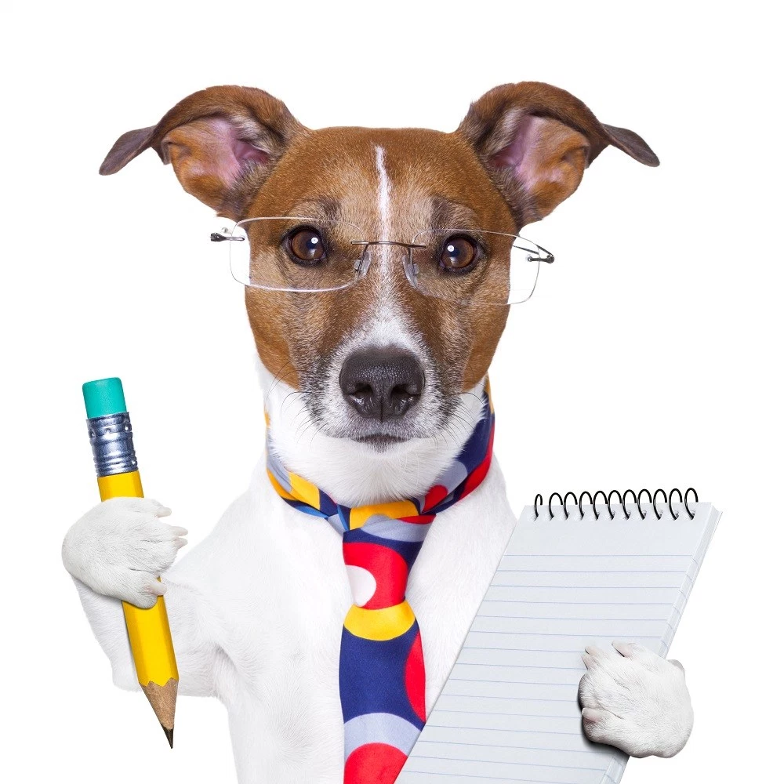
It’s writing time!

Slide 4
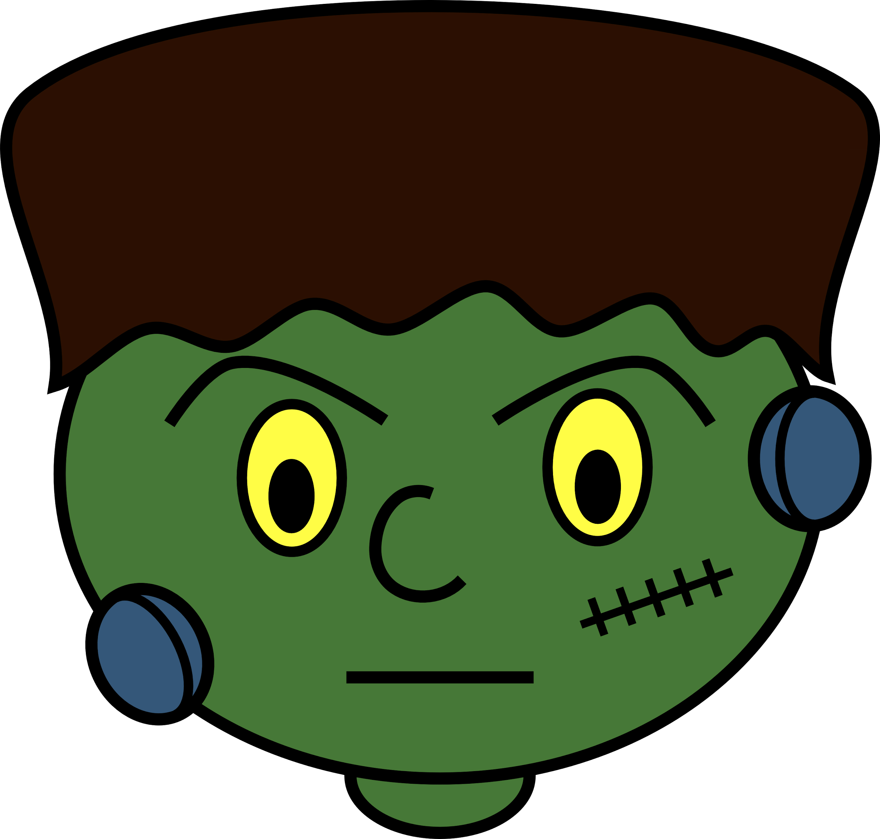
Person 1: SET THE SCENE Introduce your protagonist (main character), who they are, what they look like and what they are doing.
Person 2: CREATE TENSION Introduce your antagonist (evil character), who they are, what they look like and their interaction with the protagonist. Person 3: SOMETHING BAD HAPPENS
Explain how something bad has happened and how this happened. Explain the reactions from your characters. Person 4: RESOLUTION Explain how this problem is resolved and the impact of the crisis.

Slide 5
Person 1: SET THE SCENE Introduce your protagonist (main character), who they are, what they look like and what they are doing.
Person 2: CREATE TENSION Introduce your antagonist (evil character), who they are, what they look like and their interaction with the protagonist. Person 3: SOMETHING BAD HAPPENS
Explain how something bad has happened and how this happened. Explain the reactions from your characters. Person 4: RESOLUTION Explain how this problem is resolved and the impact of the crisis.

Slide 6
Person 1: SET THE SCENE Introduce your protagonist (main character), who they are, what they look like and what they are doing.
Person 2: CREATE TENSION Introduce your antagonist (evil character), who they are, what they look like and their interaction with the protagonist. Person 3: SOMETHING BAD HAPPENS
Explain how something bad has happened and how this happened. Explain the reactions from your characters. Person 4: RESOLUTION Explain how this problem is resolved and the impact of the crisis.

Slide 7
Person 1: SET THE SCENE Introduce your protagonist (main character), who they are, what they look like and what they are doing.
Person 2: CREATE TENSION Introduce your antagonist (evil character), who they are, what they look like and their interaction with the protagonist. Person 3: SOMETHING BAD HAPPENS
Explain how something bad has happened and how this happened. Explain the reactions from your characters. Person 4: RESOLUTION Explain how this problem is resolved and the impact of the crisis.

Slide 8
It’s editing time!

Slide 9
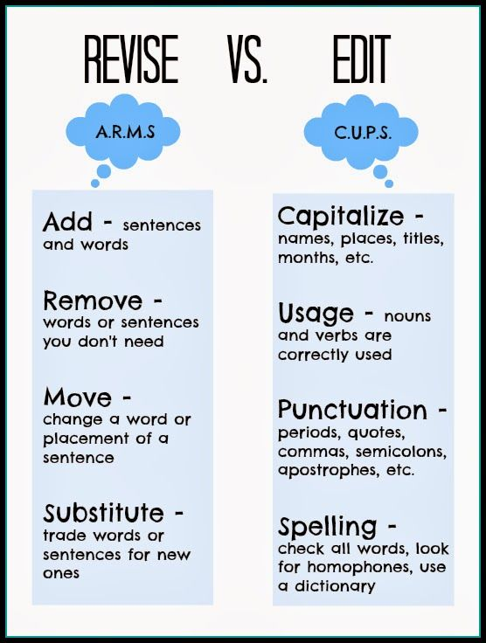
Now take your Frankenstein story and draft and edit it so that it is a quality piece of writing.
Because it has had so many authors you will need to spend some time editing it!

