Slide 1
NAPLAN PREPARATION
LITERACY

Slide 2
READING - Year 7
READING - Year 9
WRITING - Year 7
WRITING - Year 9
LANGUAGE - Year 7
LANGUAGE - Year 9

Slide 3
LANGUAGE
CONVENTIONS
(Yr 9)

Slide 5
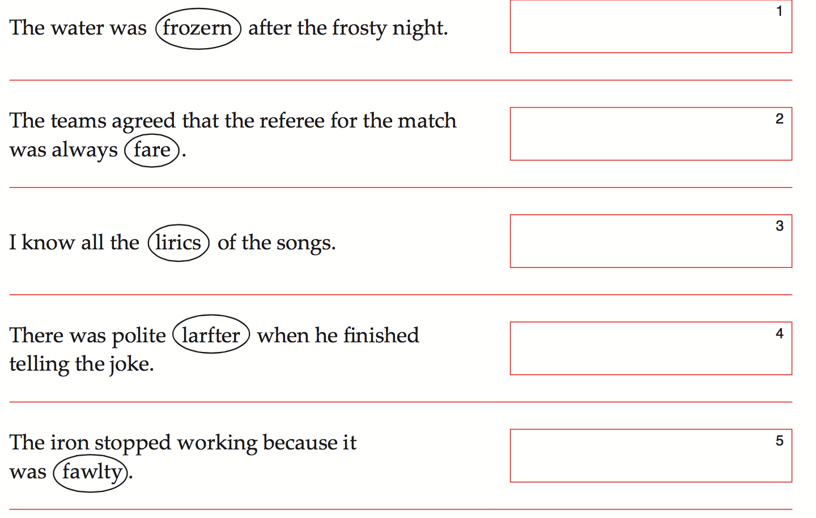

Slide 6
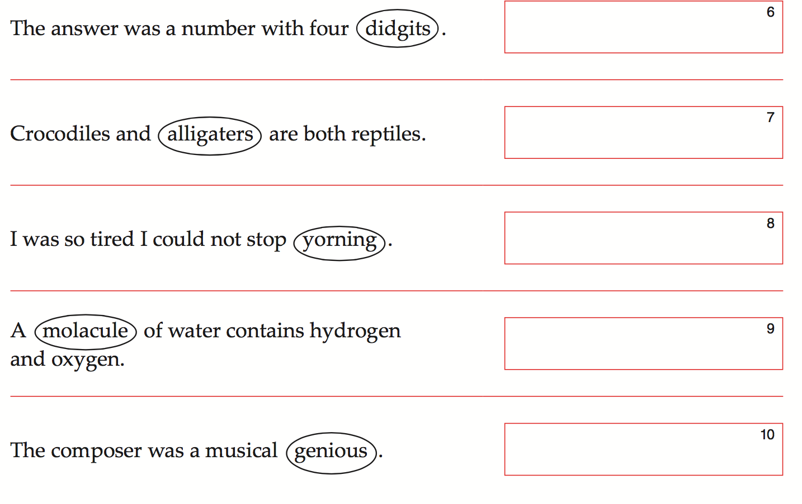

Slide 7
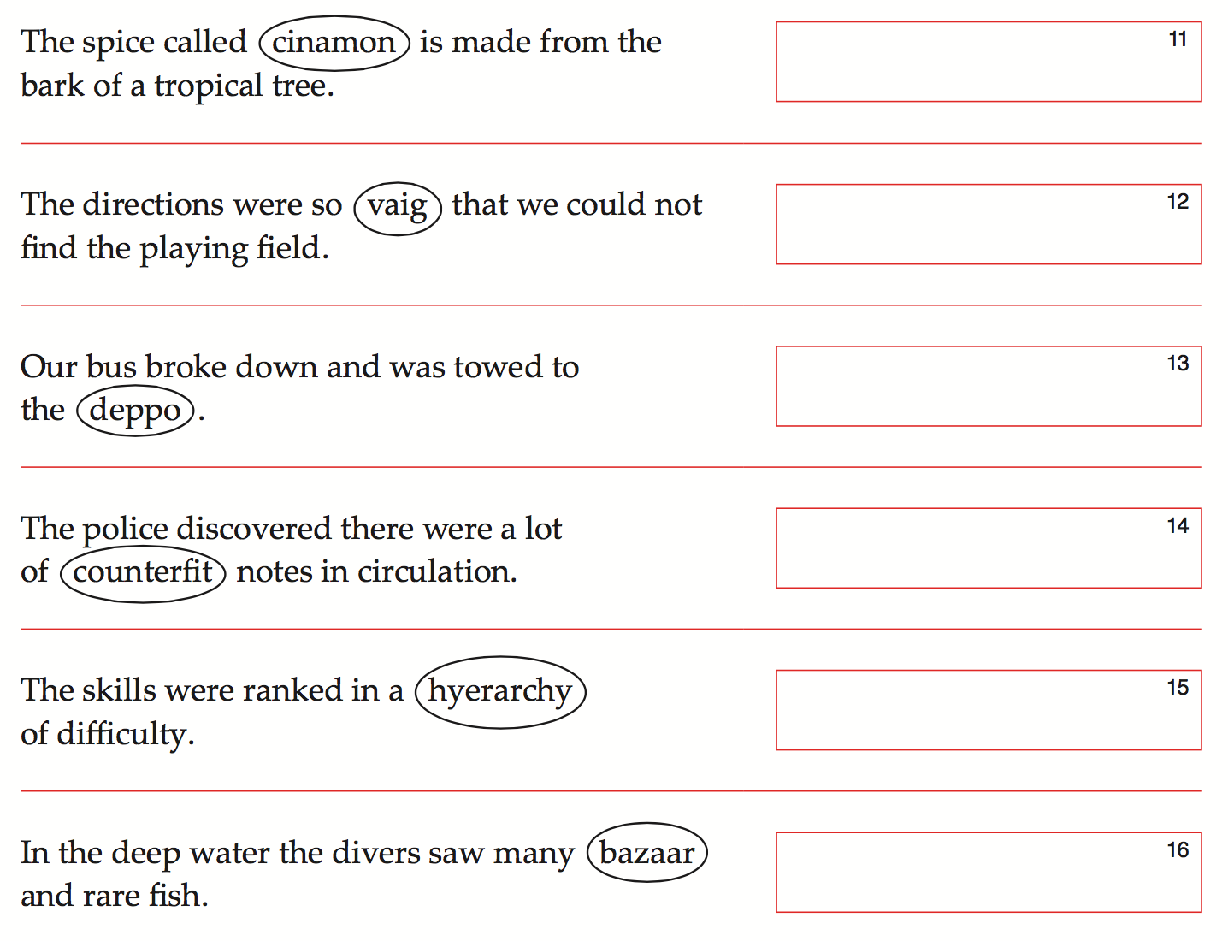

Slide 9
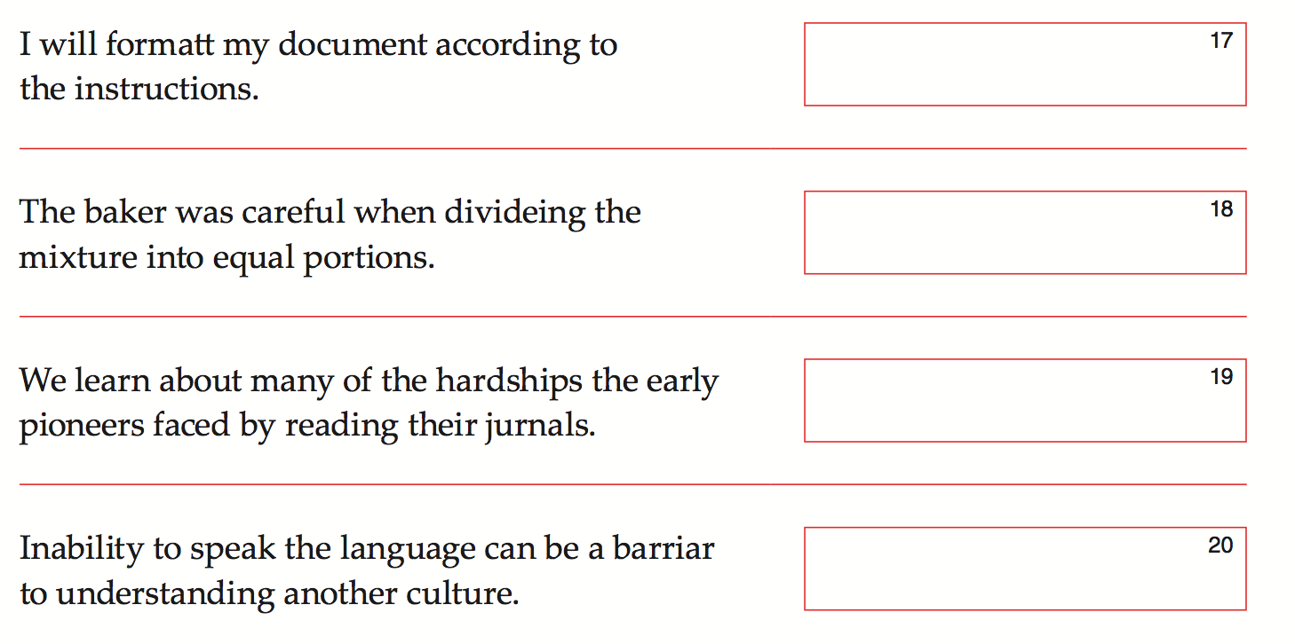

Slide 10
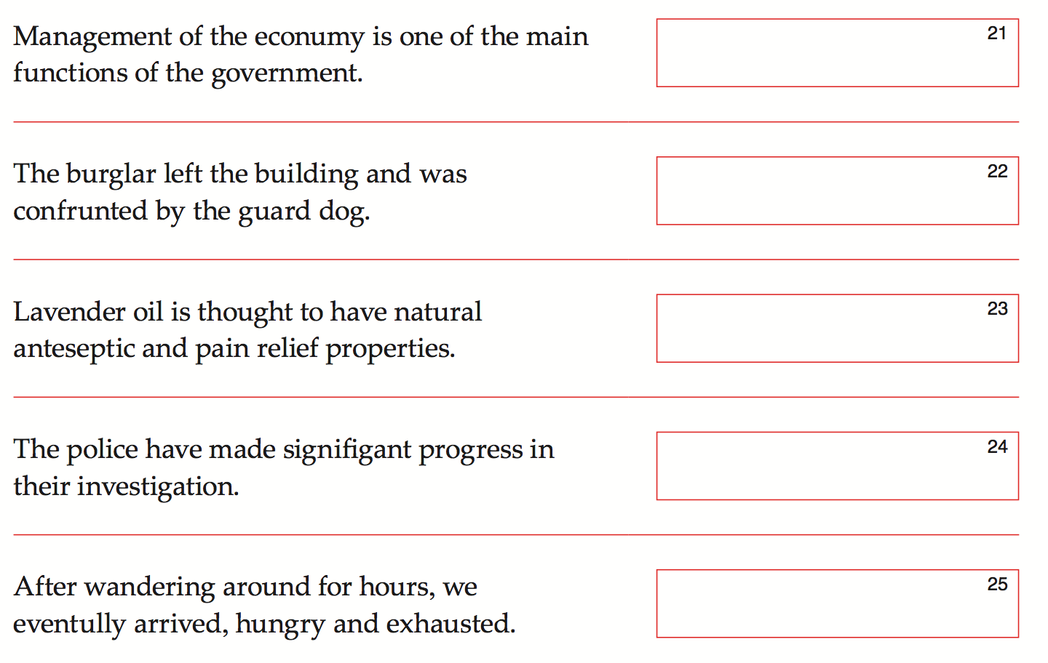

Slide 12
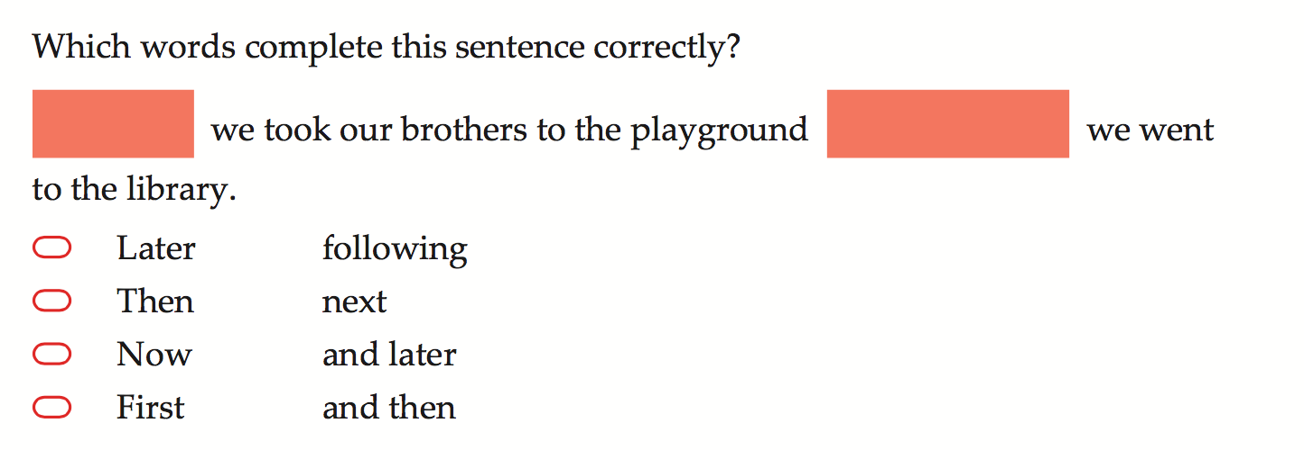

Slide 15
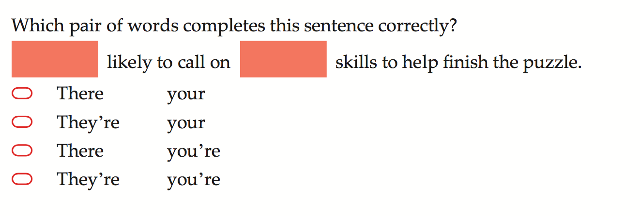

Slide 16
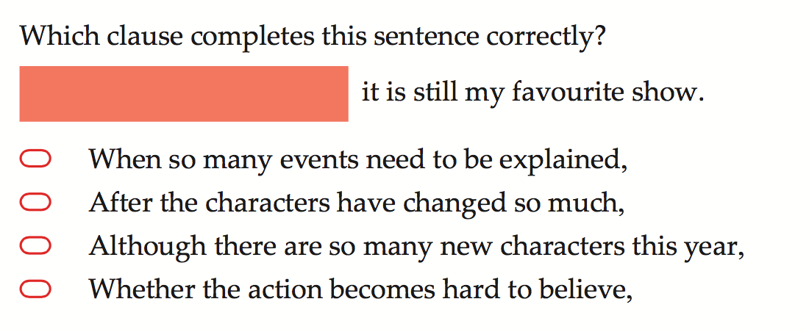

Slide 17
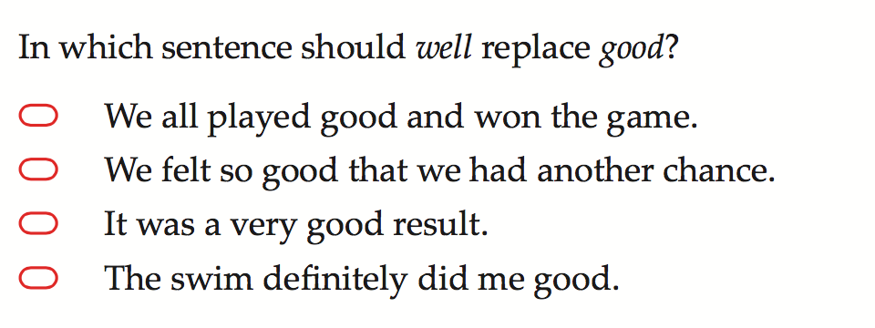

Slide 18
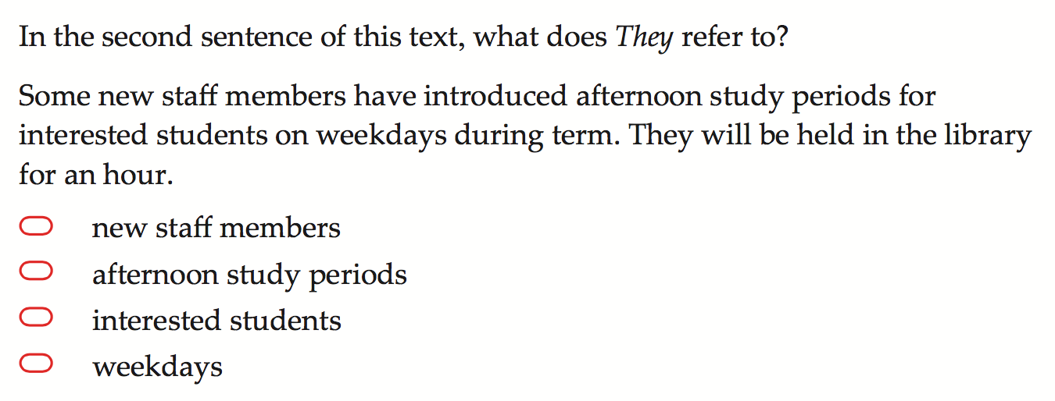

Slide 21
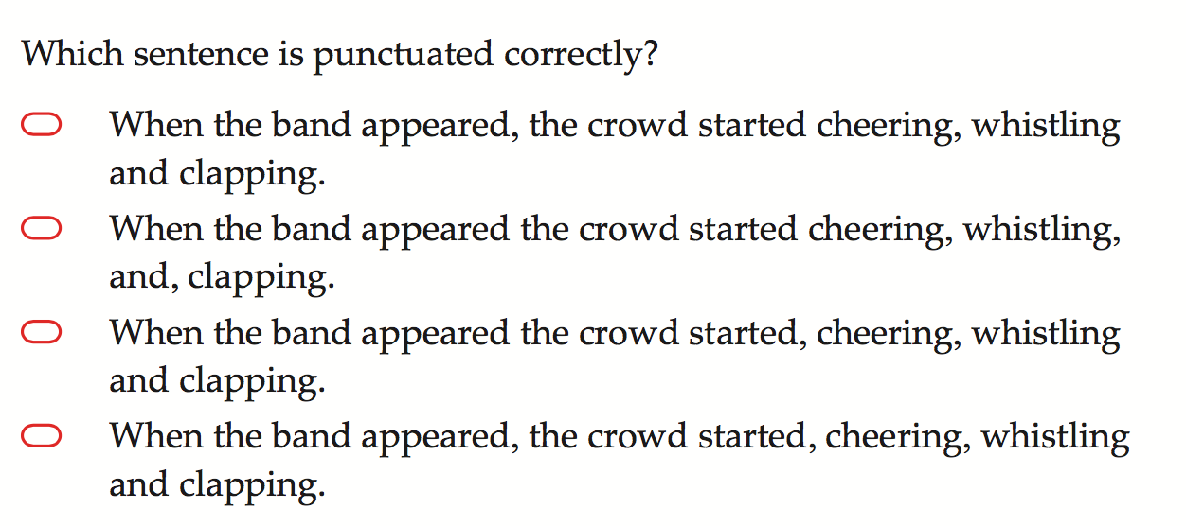

Slide 22
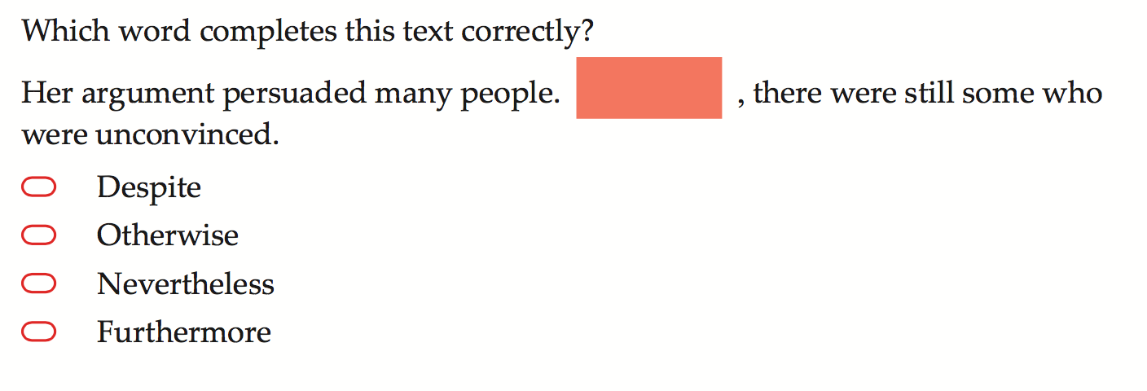

Slide 23
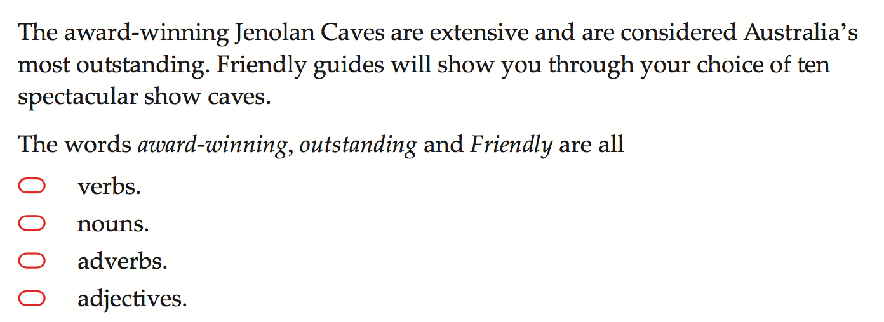

Slide 24
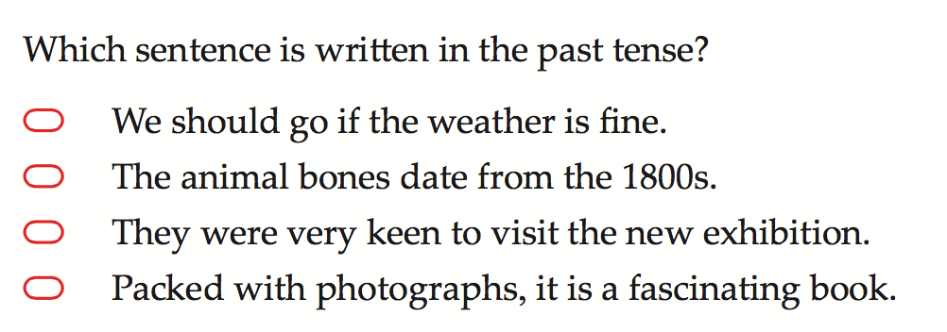

Slide 25
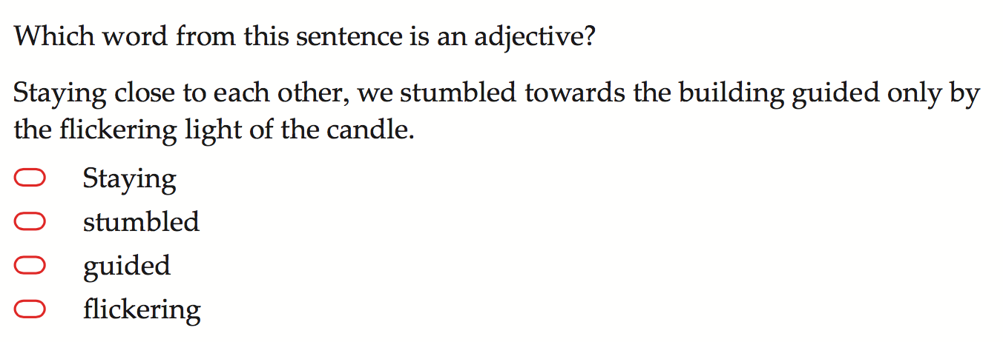

Slide 26
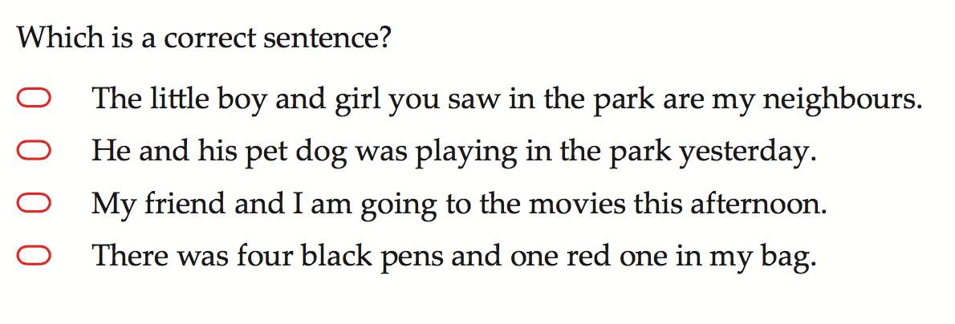

Slide 27
READING
(Yr 7)

Slide 28
Web Navigation
MAN
FROM WATERLOO
HUNTING
UNDER
ICE
Click on one of the above links to practice your reading and comprehension!

Slide 29
READING
(Yr 9)

Slide 30
READING MAGAZINE
Set 1
Reading QUESTIONS
Set 1
Click on one of the above links to practice your reading and comprehension!

Slide 31
READING MAGAZINE
Set 1
Reading QUESTIONS
Set 1
Click on one of the above links to practice your reading and comprehension!

Slide 32
WRITING
(Yr 7 & 9)

Slide 36
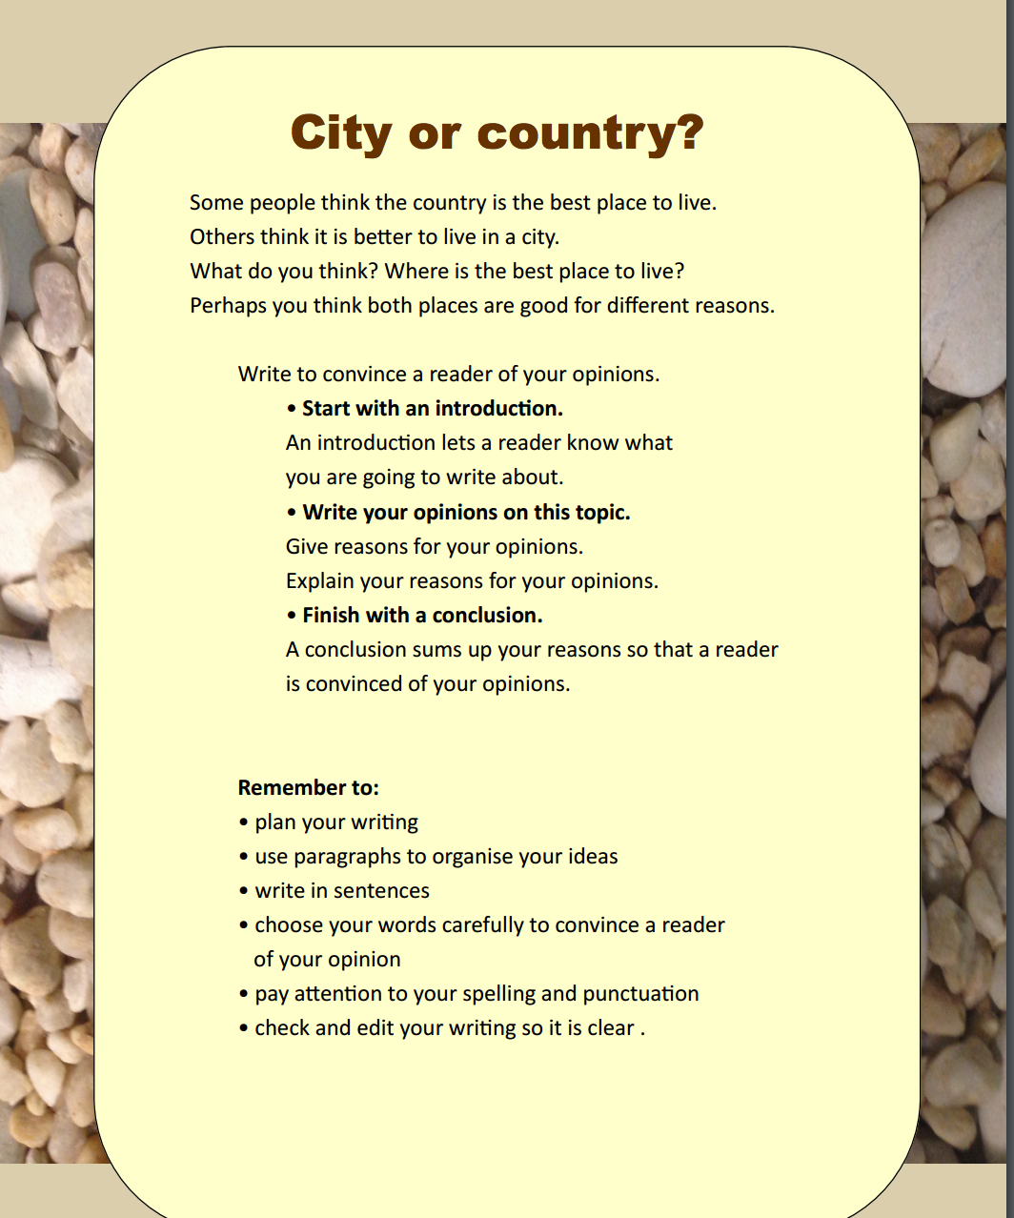

Slide 39
Which is better? Why?? 1. Animals should not be kept in cages because it’s wrong. If an animal is in a cage they can’t move of be happy. I think that if i saw an animal in a cage i would be sad. They are sad too. Chickens are kept in cages and some are never allowed out. At chicken farms lots of chickens die a horrible death. 2. Imagine if you never saw daylight. Imagine if you couldn’t move your arms. Imagine if you were forced to sit in your own mess, never moving, never living. This is what happens when animals are forced to live in cages. It is cruel to keep animals in cages and this needs to stop now.

